Slide 1






R&D Project Management
Presentation 2024
Group D

Slide 2








Scrum Team
PRODUCT OWNER
Nimisha vilayatrani
SCRUM MASTER
Mariem Garfa
DEVELOPERS
Chowdhury Abida Anjam Era
Jaffar Alkaales
Nafise Askari
Tester
Mohammad Mehrbod
Tazeen Zahra
UI / UX
Yu Tian
Varsha Vijayan
Group D

Slide 3




No Tracking
No Guidance
Challenges of the old App
No service
Uniflow
Poor support
Is what you need
Long cycle times

Slide 4


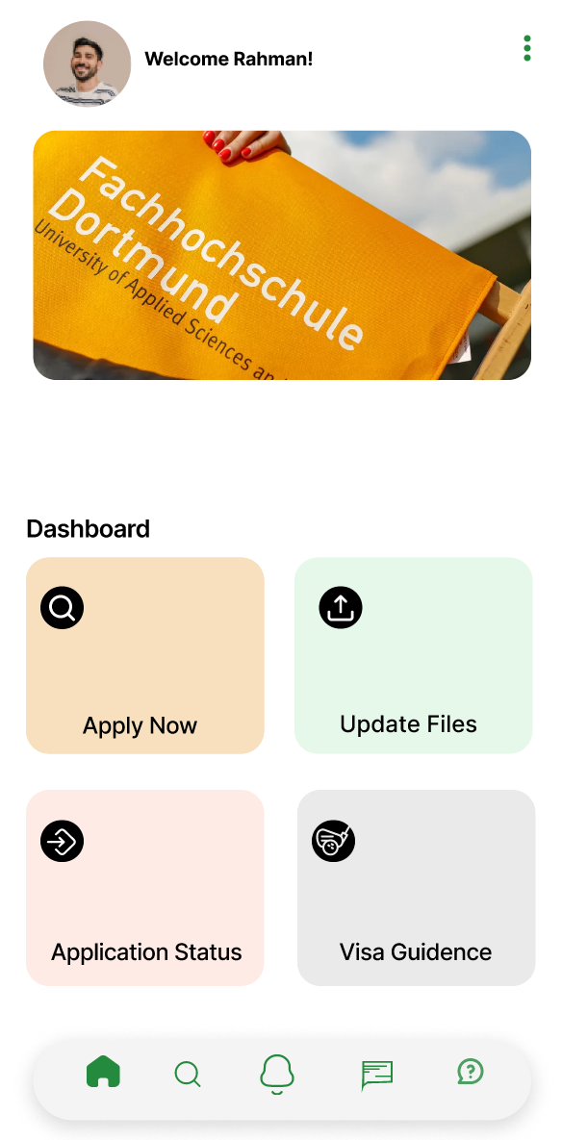
Overview
1. User /Student Dashboard:
2. FAQ (Frequently Asked Questions):
3. Contact:
4. Choose Study Program:
5. Submit Application Docs:
6. Track Application Status:
7. Cases of Admission for Enrollment:
8. Email Address and Relevant Information:

Slide 5

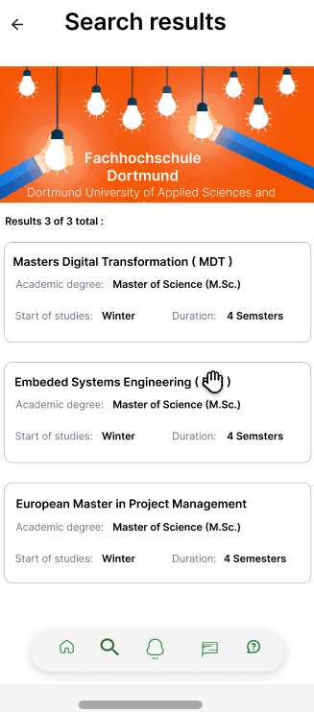
Key Features
of Uniflow
01
02
03
Good support system chat, email, FAQ, and contact pages self-provide information.
Visa help
Pre-check facility
04
05
06
Properly understandable dashboard
The portal is clear well defined easily understood
Ease of use

Slide 6







USEFUL TOOLS
JIRA
CONFLUENCE
FIGMA

Slide 7
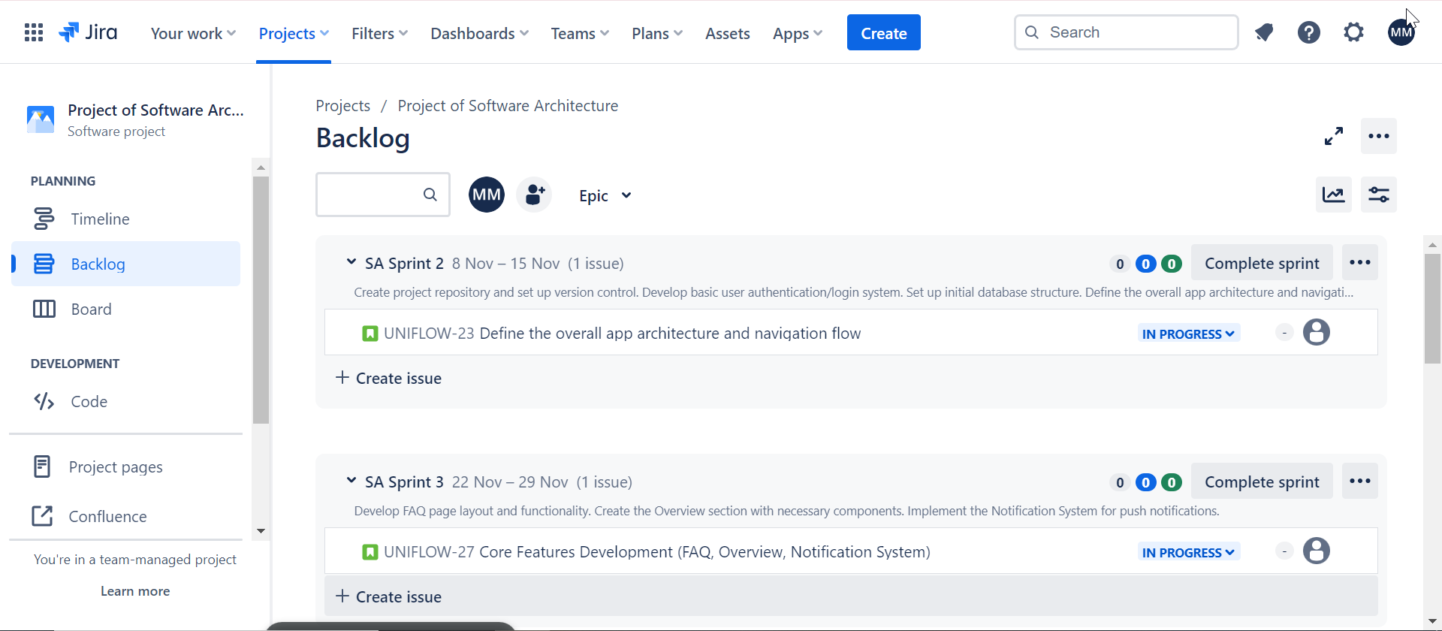
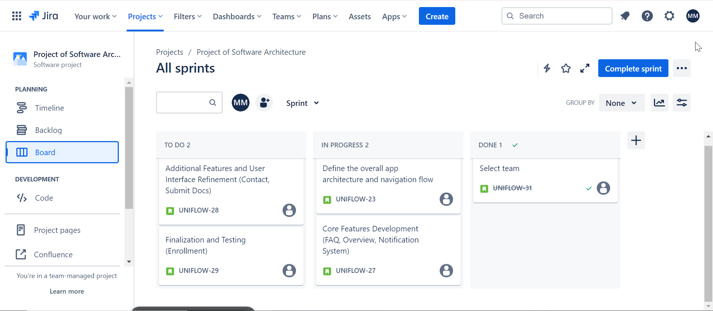

The target of using Jira is to provide teams with a flexible and powerful platform for managing and tracking their work, promoting collaboration, and improving overall project and team efficiency.
Jira

Slide 8

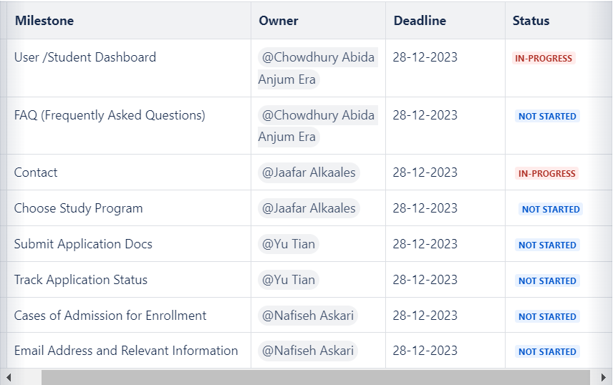
Confluence aims to provide teams with a collaborative and organized platform for creating, sharing, and managing documentation and knowledge. It aims to improve communication, streamline collaboration, and create a centralized repository of information for teams and organizations.
Confluence

Slide 9

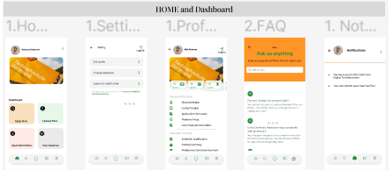
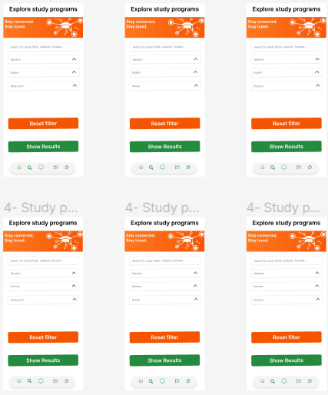
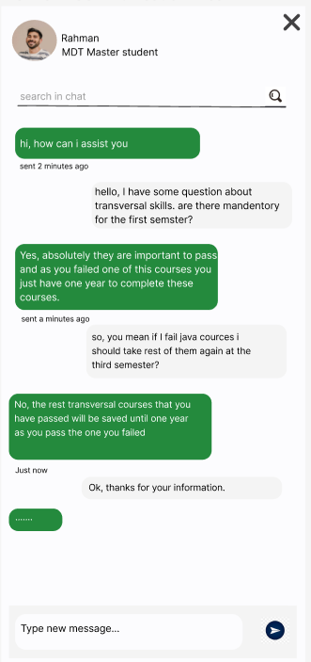
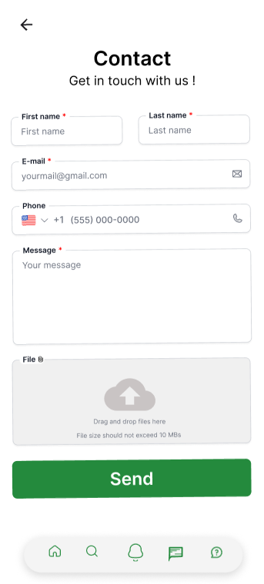
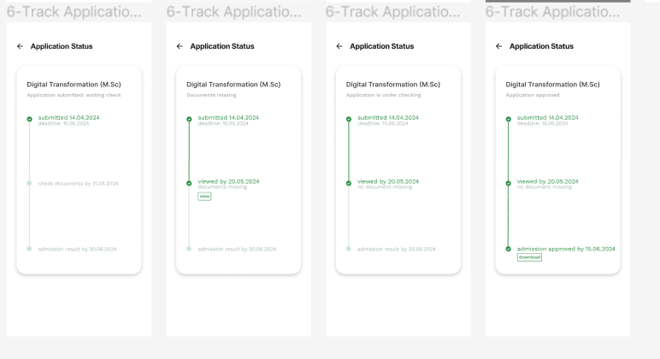

Here are some of the key features and pages we did in Figma :

Slide 10
Uniflow
Thank you for your time and attention.
Winter semester 2023
Group D

